Slide 1
Lord of the flies
-William Golding
Chapter Summaries
“Lord of the Flies was simply what it seemed sensible for me to write after the war, when everybody was thanking God they weren’t Nazis. And I’d seen enough and thought enough to realize that every single one of us could be Nazis….”

Slide 2
Chapter 1: “ The Sound of the Shell”
Two boys, Piggy and Ralph, making their way through the jungle.
We learn, through their dialogue, that they had been travelling in an airplane with a group of British school children.
  The plane had presumably been shot down and crashed on a an island in the Pacific. It is hinted that the rest of the world is at war, and that most of it has been destroyed by nuclear attacks -- possibly explaining that the children were being evacuated.
They make their way to the beach where they find a large conch shell. Using the shell as a horn, Ralph summons any other children that may be on the island.
They begin to come from the jungle and Piggy takes names.
Two marching files of black-clad children approach.
  This is the first we see of Jack Merridew.

Slide 3
Chapter 1 Continued …
  They decide to vote for a chief "to decide things." It is obvious the only two contenders are Jack and Ralph.
  Ralph is voted in; he had possession of the conch -- already magical in quality to those present -- and seemed the most able.
    Jack's black-clad choir are designated as hunters upon Jack's insistence.
Ralph's first decision as chief is to send a party out to investigate whether or not they are really on an island. Himself, Jack, and Simon leave to scale the mountain.
They reach the summit and indeed discovery they are on an island.
They discover a piglet caught in the underbrush. Jack unsheathes his knife and raises it, ready to let fly -- but he cannot.
  His current nature will not let him spill blood. He is embarrassed and promises that next time he will kill.

Slide 4
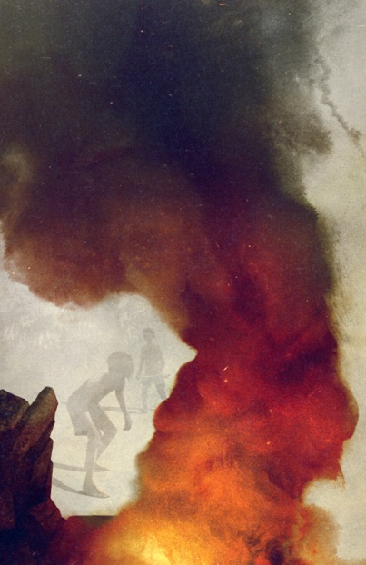
Chapter 2: “Fire on the Mountain”
Ralph calls another meeting by blowing on the conch.
  He conveys to the group of kids that they are on an island with no grown ups
  Jack insists on having an army of hunters and begins talking excitedly about the piglet. No one can talk, unless they’re holding the conch.
Ralph lays down some rules:
  First, when someone wishes to speak at an assembly he must hold the conch shell.
  The conch begins to symbolize the organization of society and the rules that such a society must uphold to function.
They speak excitedly about their new temporary home, how it is a "good island" and how much fun it will be.
  Then, a littlun with a large birthmark on his face steps forward to speak.
  The child tells of a "beastie" that he saw in the dark. It looked like
  a snake and is the first manifestation of the Beast.
Ralph doesn't think a beast could live on a small island,
but he feels himself "facing something ungraspable."
Jack says his hunters will kill the beast if, indeed, it does
exist.

Slide 5

Chapter 2 Continued …
Ralph then introduces another prevailing symbol of the novel: the signal fire.
  He will make it paramount that a signal fire be maintained to aid in their rescue. At mention of creating such a fire at the top of the mountain, the children become excited and rush off, lead by Jack, to the summit to see if they can complete such a task.
A huge pile of gathered wood is made on the top of the mountain. Jack, against Piggy's protest, grabs his specs to light the fire with.
The group of hunters are divided up to take shifts keeping the fire going. It is then noticed that the sparks from the now-dead fire have ignited half the forest below the mountain.
Piggy speaks out against the group's immaturity. He tells them that they ought to be more responsible, they don't even know how many kids are on the island. Jack argues against him.
Piggy points to the inferno and asks where the boy with the birthmark is. Nobody knows he has been killed by the fire. He is the first to die and the boys can only stare at the fire, marveling with horror at what they have done.

Slide 6
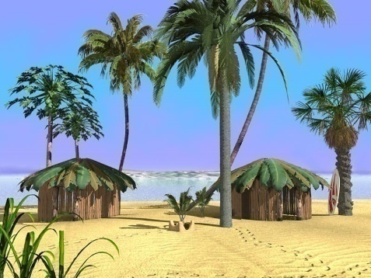
Chapter 3: “Huts on the Beach”
The chapter begins many days, possibly weeks, after the fire on the mountain.
Jack is hunting for pigs and has become good at tracking them, but has not killed one as yet. He comes back to the beach where Ralph and Simon are trying to build a hut.
Two rickety huts have already been constructed and this last one is not turning out so well.
Ralph complains to Jack how the kids don't help; they are bathing or eating fruit in the forest instead.
Jack and Ralph have a small argument about whether building huts is more important than hunting. This is the first of many disputes they will have.
The subject of the beastie comes up again. Many of the littluns are frightened of it, which is why they are building huts.
  Jack comments that when he is alone hunting he feels he is, "not hunting, but being hunted... As though something is behind you all the time in the jungle."
Simon wanders into the jungle, helps the littluns pick fruit, and then walks deeper into the forest and eventually finds a thick jungle glade, a peaceful, beautiful open space full of flowers, birds, and butterflies.
He looks around to make sure that he is alone, then sits down to take in the scene, marveling at the abundance and beauty of life that surrounds him..

Slide 7
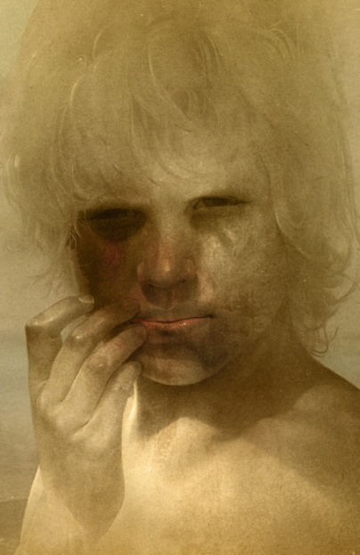
Chapter 4: “Painted Faces and Long Hair”
Roger and Maurice are walking through a group of littluns, kicking over the things they've made in the sand.
  Roger begins throwing rocks at the littlun, but he aims to miss, because "the taboos of the old world" are still with him.
Jack puts on a "mask" of painted camouflage in order to hunt pigs better.
  As Jack smears the clay on his face, the mask is "...a thing on its own, behind which Jack hid, liberated from shame and self-consciousness." The mask allows Jack to not worry about rescue and what he knows is right. Behind it he can do what he likes.
A boat is spotted on the horizon. Ralph looks to the mountain top, but the signal fire has gone out.
Jack and a crowd of hunters move up to the summit, carrying a dead pig.
When Ralph tells them a ship passed the island they fall silent.
  Jack tries to make excuses, and during Piggy's protests and lecturing Jack punches
  him and he falls to the ground. His specs go flying and one lens breaks.
The fire is re-lit and the pig is roasted. Jack hands out portions of
meat to all the boys except Piggy.
  Simon gives his portion to Piggy and Jack can't stand it.
The story of the hunt is re-enacted by the boys. Maurice pretends to
be a pig, while the rest dance and chant around him.
  This is the first time the "dance" is preformed.

Slide 8
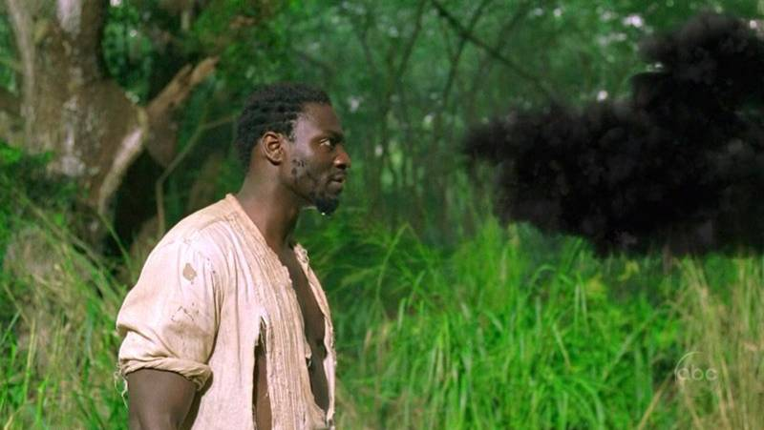
Chapter 5: “Beast From Water”
An assembly is called and the group of kids come. Ralph talks about how they start projects and never finish them.
  He tells them that "...we ought to die before we let the fire out." He tells the hunters that the fire is more important than a pig. Furthermore, he explains that, "Things are breaking up. I don't understand why. We began well; we were happy. And then--...Then people started getting frightened."
They are all frightened of the Beast, and the children have been talking about it -- a large animal living on the island.
  The Beast, in reality, is something that resides in all of the kids -- a sort of dangerous evil that must be withheld. Ralph, from the start, has tried to hold it back by laying down rules and organizing society. Nonetheless, none of the kids yet realize this, and the Beast is manifested in their minds as an animal lurking on the island.
Piggy gets up and makes a very important speech in which he states that there isn't a beast, at least, "not with claws, and all that..." Also, "there isn't no fear either...Unless we get frightened of people."
A littlun comes forward and talks of how he had been dreaming about fighting the creepers and saw something "horrid in the forest."
  It turns out that the horrid thing was Simon, who had been returning from the clearing he likes to be at. Another littlun comes forward, Percival, and explains another type of beast -- the Beast from the water.

Slide 9
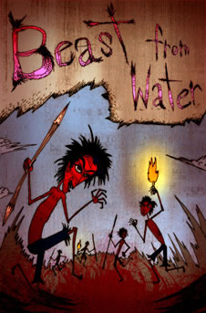
Chapter 5 - Continued
Again, this is debated. Then, Simon takes the conch and says something very important. He says that, "Maybe there is a beast... What I mean is... maybe it's only us." Simon begins to understand what the Beast really is, but his is jeered at.
The debate continues and turns toward talk of the rules. Jack doesn't know why Ralph has the right to make rules. He points out that Ralph cannot hunt, nor can he sing. Ralph counters that he was chosen and that is reason enough.
More arguing ensues, and, "The world, that understandable and lawful world, was slipping away."
Jack turns against Piggy as well: "Bullocks to the rules! We're strong -- we hunt! If there's a beast, we'll hunt it down! We'll beat and beat and beat!" Jack does not like rules and the Beast within him his beginning to expose itself little by little.
The assembly breaks up and the hunters do their dance once again.
  The boys are drifting apart into two distinct groups: those who follow Ralph’s
ideas and those who follow Jack.
At the close of the chapter, Ralph, Simon and Piggy are sitting on the
assembly platform listening the cries of the littluns' nightmares.

Slide 10
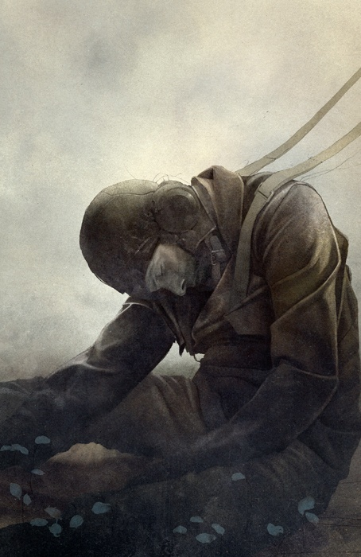
Chapter 6: Beast from Air
Two fighter planes are engaged in a nighttime battle over the island -- more evidence that the world is at war.
One of them is shot down and the pilot bails out and opens his parachute, but he is already dead.
As the victor flies away the dead man floats to the island only to be caught on the rocks of the mountain. There he will stay for some days, slowly rotting.
The twins, Samneric, are on fire duty and have fallen asleep. They wake up, re-light the fire, and see the "Beast from air" breathing in and out. They run to tell Ralph.
The kids all believe that they are now in terrible danger.
It is decided that a party of hunters, plus Ralph and Simon, will go to hunt the Beast.
They will first check the only place on the island that no one has been to: Castle Rock.
They trek to the castle and discover that nothing is there. Jack exclaims that the rock would make a great fort and he and his hunters push a boulder into the sea.
Ralph breaks up the fun and they start the journey to the mountain.

Slide 11
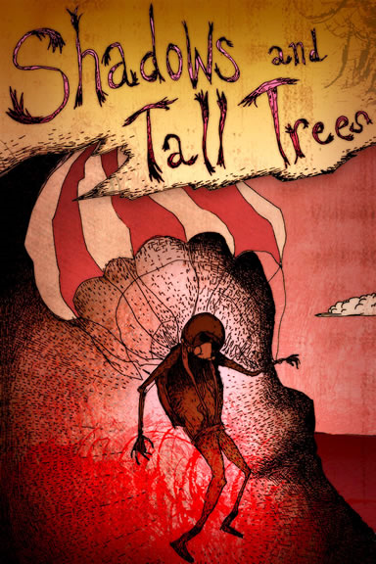
Chapter 7: Shadows and Tall Trees
As they make their way to the mountain Ralph thinks about how dirty and scraggly they all look.
  He yearns to have his hair cut and take a bath -- longing to hold back the wild.
They start off and Jack finds traces of a pig. They decide to hunt it.
A boar is found and Ralph wounds him with his spear. He is delighted that he made the only strike on the animal.
The boar gets away and the hunters begin to dance again, but this time it is a little different.
  Robert is playing the part of the pig, but the kids are out of hand and some of the fake blows to the "pig" are landing hard. Even Ralph feels that, "...the desire to squeeze and hurt was overmastering."
  Here is the first time we see Ralph having trouble suppressing the Beast.
They continue to the mountain and Simon is sent through the forest to tell Piggy and the others that the hunting party will not be back before dark.
Night falls as they reach the base of the mountain and the boys argue about whether or not they should wait until morning to scale it.
Jack goes to the top and comes back down, reporting that he saw something
billowing up on top.
They all climb to the summit and see the Beast. Instead of fighting it and finding
out that it is only a man, they run.
As they flee, "...the creature lifted its head, holding toward them a ruin of a face."

Slide 12
Chapter 8: Gift for the Darkness
Jack calls an assembly by blowing the conch. He tells the group that the Beast is real.
Ralph has called the hunters cowards and Jack accuses Ralph of being a coward himself.
  Jack asks the assembly if any of them think Ralph should not be chief. No one raises their hand. Jack, in defiance, says, "All right then... I'm not going to play any longer. Not with you...I'm not going to be a part of Ralph's lot."
Simon steps forward to propose that they climb the mountain. No one wants to.
Piggy decides that the signal fire should be moved to the beach, and the kids start building a fire.
Most of the bigguns have left to go "play" with Jack. The only bigguns left are Ralph, Piggy, Samneric and Simon.
Jack gathers a group of boys in the forest. They decide that Jack will be chief. They begin to track a pig and and it leads them to Simon's clearing.
Jack decides to offer the pig's head as a gift to the Beast.
  He orders his new henchman, Roger, to “sharpen a stick at both ends.”
  Simon climbs from under the creepers and is confronted with the head.
Jack and his gang raid Ralph's encampment. They steal a burning log and Jack invites all the boys to come join his tribe at the feast they are to have that night.

Slide 13
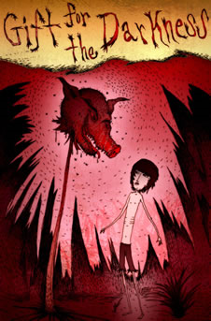
Chapter 8: Continued …
As the "savages" leave Ralph comments about how he wishes he could have fun too, but still the fire is more important to him.
  This importance of the fire and of rescue are drifting away from Ralph and he must be constantly reminded of it by Piggy.
Back at the clearing Simon is having a "discussion" with the pig's head. This discussion is probably in Simon's head, but Golding uses this interview as an eerie way to unveil the theme of the novel.
The Lord of the Flies asks Simon if he's afraid of him. It says:
  "...I am the Beast... Fancy thinking the Beast was something you could hunt and kill! You knew, didn't you? I'm part of you? Close, close, close! I'm the reason it's no go? Why things are the way they are?"
  Although Simon may have known that the Beast was really inside the
  kids, it is now confirmed. Now that Simon knows for sure, the Beast
  warns him not to tell anyone the truth, otherwise he will be killed.

Slide 14
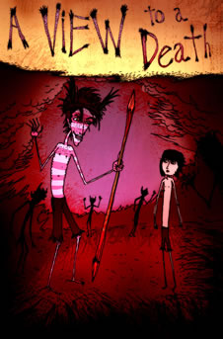
Chapter 9: A View to a Death
A storm is boiling over the island, possibly representing the turmoil that is occurring below it.
Simon regains consciousness and heads for the mountain. He sees the rotting airman and realizes the Beast is "harmless and horrible," which, in reality is true.
Piggy and Ralph have decided to go to the pig roast.
  All of the other boys are already there, except Simon, and they fall silent as the two outcasts approached.
They are both given portions of meat as Jack begins a speech.
  Ralph interrupts -- trying to persuade the boys to help him keep the fire going. The crowd of boys instead agree to join Jack, who promises to give them meat and keep them safe from the Beast.
The storm breaks and the rain comes down with lightning and thunder.
Jack orders them to begin the dance.
  As they chant around Roger, who is playing the pig, Piggy and Ralph "...found themselves eager to take place in this demented but partly secure society."
  The boys in the dance are armed with clubs and spits and are getting out of hand again with this game.
A figure is crawling out of the forest and the ring opens to let it inside.
  Mistaken as the Beast, Simon is beaten to death and “there was the throb and stamp of a single organism.”
On top of the mountain wind fills the parachute of the airman and lifts him away from the island.
As the storm subsides and the tide moves in and out, Simon's body is washed to sea.
  “Softly, surrounded by a fringe of inquisitive bright creatures, itself a silver shape beneath the steadfast constellations, Simon's dead body moved out toward the open sea.”

Slide 15
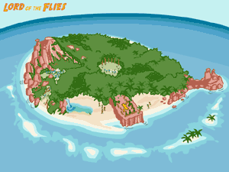
Chapter 10: The Shell and the Glasses
It is the next morning and the only boys still in Ralph's confidence are Piggy and Samneric.
Ralph and Piggy discuss Simon's murder.
  Piggy tries to make excuses for the boys by claiming it was an accident, but Ralph doesn't buy into that.
On Castle Rock Jack (now continually painted) has created a fortification that is constantly guarded.
If they need to defend themselves, Roger has placed a lever underneath a large boulder that will send it smashing onto the rock bridge below.
Jack has begun to rule by force and the kids who are out of line are tied up and beaten. He decides the tribe will hunt again tomorrow.
Although some of them realize they have killed Simon it is sensed that they are trying to it cover up by convincing themselves they really just hurt the disguised beast.

Slide 16
Chapter 10 Continued:
Back at the lagoon Ralph and the rest are agonizing over trying to keep the fire going.
  Again, Ralph must constantly be reminded by Piggy that the fire is "Something overwhelmingly good."
Ralph tells the protesting twins that:
  "Anyone can play at hunting, anyone can get us meat"; anyone can buy into the irresponsible and harmful desires within them, but it is not easy to hold them at bay.
They decide to leave the fire unlit for the night, and retire to the shelters.
During the night they awake to noises outside and they are afraid the Beast has come for them, but it is only Jack and his tribe searching to steal fire.
  They charge into the shelter and in the violent fight that ensues, Piggy's specs are stolen.
They have now been stripped of the ability to make fire and the only symbol of society and order that is left to them is the conch.

Slide 17
Chapter 11: Castle Rock
In desperation Ralph calls an assembly.
  Only the four boys plus some littluns attend.
Ralph speculates that maybe if they try to comb their hair, and look decent they could go to Jack to ask for the specs, " -- after all we aren't savages really and being rescued isn't a game"
Piggy talks about Simon's murder and the death of the littlun in the first fire:
  "What can he do more than he already has? I'll tell him what's what. You let me carry the conch, Ralph. I'll show him the one thing he hasn't got."
They set off; with Ralph and the twins carrying spears and Piggy the conch.
They reach Castle Rock and Roger orders them to halt and Ralph blows the conch.
  Jack emerges from the forest behind him with his hunters and the carcass of a pig.
Ralph demands the specs to be returned and the tribe laughs at him.
  Ralph and Jack fight and some kids come out to tie up Samneric.
Piggy stands up and yells for them to stop and listen to him. Surprisingly, the crowd is silent and Piggy, holding the conch, asks,
  "Which is better -- to have rules and agree, or to hunt and kill? Which is
  better, law and rescue, or hunting and breaking things up?"

Slide 18
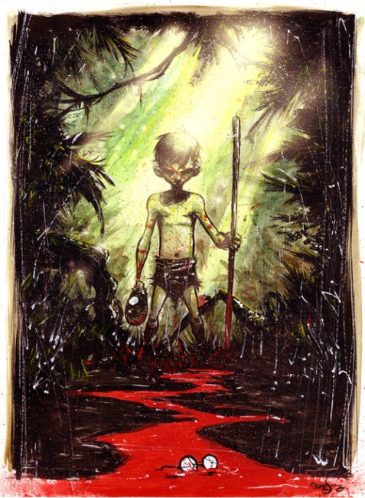
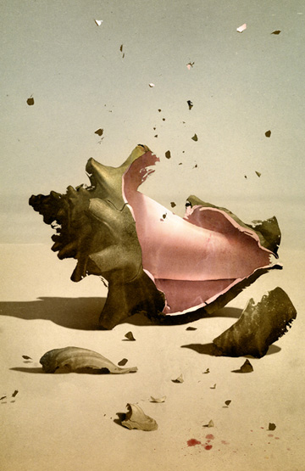
Chapter 11 Continued …
A great yell goes up and Roger heaves on the lever. The huge boulder totters and crashes onto the bridge.
Ralph ducks out of the way, but the blind Piggy does not move. As the boulder strikes him the conch explodes "...into a thousand white fragments..."
  Piggy falls forty feet to his death on the rocks below.
Jack feels no sympathy and warns Ralph that that's what he'll get.
The tribe charges and Ralph is running, crashing through the forest.
The pursuit does not last long and Jack orders the crowd back to the fort.
  Ralph is free, for the time being.

Slide 19
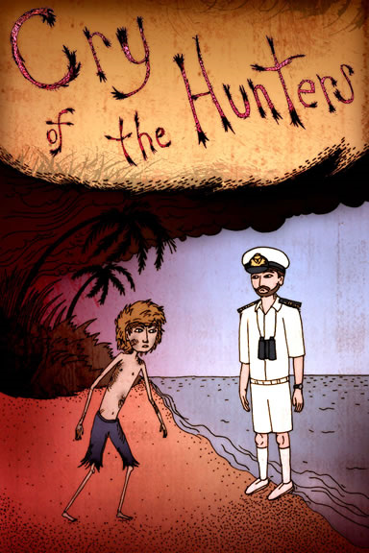
Chapter 12: Cry of the Hunters
Night falls and Ralph stays close to Castle Rock.
  Samneric, now savages, have been stationed as guards.
Ralph scales the tower to talk to them. They tell Ralph that Jack and the tribe are going to hunt him tomorrow.
The plan is that the kids will make a line stretching from one shore of the island to the other and they will slowly advance until they find him.
When Ralph asks what they will do when he is caught, the twins reply, "Roger has sharpened a stick at both ends," but Ralph does not attach meaning to this.
He tells Samneric that he plans to hide in the thicket near Castle
Rock, thinking that Jack will not look so close to the fort.
Ralph wakes up the next morning and the twins have been forced to
confess where Ralph is hiding.
  The tribe tries to roll another boulder from the castle to land in Ralph's
  thicket, but they just barely miss him.
A savage tries to crawl through the branches to see if Ralph is still
there and gets the business end of a spear.

Slide 20
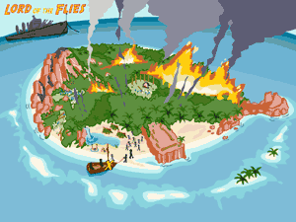
Chapter 12 Continued …
They set the thicket on fire and Ralph runs into the forest as the line of savages spreads out to begin the sweep of the island.
  Deciding that the best option is to hide, Ralph finds the place where Simon used to stay and hunkers down.
As the line of savages advances, the entire island behind them is burning, but they only seek to catch and kill Ralph.
The line reaches his hiding spot and Roger peeks under to look. Ralph charges him and runs to the beach, the tribe pursuing.
He runs past the burning shelters right into a Navy officer.
  Ironically, the massive fire and smoke enabled the ship to see them.
As the boys gather around, the officer comments on how it must be all be fun and games. Some of the boys are crying, realizing what they've done.
The officer sees the spears and asks, "We saw your smoke. What have been doing? Having a war or something?"
He learns that two children have been killed and they are taken off the island to the waiting cruiser.
As they are taken away, "...Ralph wept for the end of innocence, the darkness of man's heart, and the fall through the air of the true, wise friend called Piggy."

