Slide 1
Lord of the Flies
Introduction Questions

Slide 2
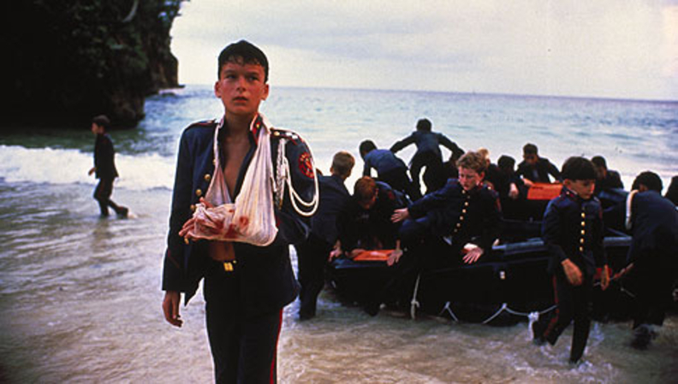
Do All Groups Need Leaders?
Can people work without a leader?
Does someone always “become” leader?
Agree – Disagree?

Slide 3
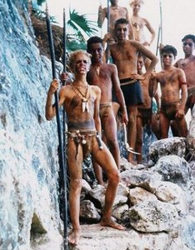
What Are the Qualities of a Leader?
Good qualities?
Bad qualities?
Do all good leaders have same qualities?
Does it depend on who is being led?
Why are the qualities important?

Slide 4
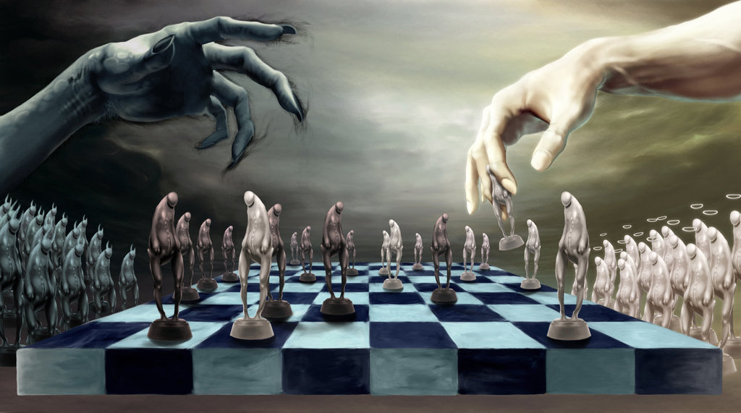
Are Humans Naturally Good or Evil?
Nature vs. Nurture
Are we born “innocent”?
How/Why do we learn “evil”?

Slide 5
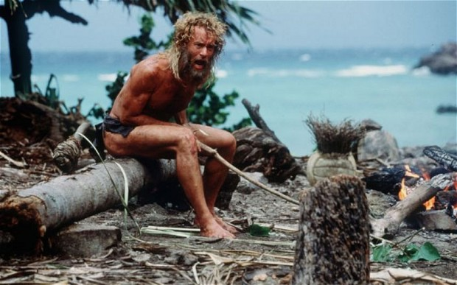
What Rules Would You Create If You Were Stuck on an Island?
What would be your first priorities?
What rules would keep everyone civil?
What challenges do you think you’d need to overcome?

