Slide 1
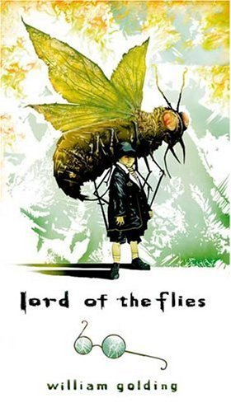

Slide 2
About William Golding
British novelist
Born on September 19, 1911, died 1993
Studied Science and English at Oxford
Fought in Royal Navy during WWII
Participated in invasion of Normandy on D-Day
At war’s end, returned to teaching and writing
Earned the Nobel Prize in Literature

Slide 3
The World Golding Knew
WWII 1939- 1945
The fall of France to Nazi Germany in 1940
Britain feared an invasion and evacuated children to other countries
1940- A German U-Boat torpedoed a British ship carrying children, killing the boys, thus suspending the oversees evacuation program

Slide 4
Events of WWII
1939- Britain joined France in war against Nazi Germany
1940- Fall of France
1940- Fascist Italy joins the Axis with Germany
1941- Japan attacks Pearl Harbor causing USA to declare war on Japan and enter the war
1944- D-Day Normandy Landings
1945- Bombing of Dresden
1945- European victory celebrated
1945- Atomic Bomb dropped in Hiroshima immediately killing 60-80,000 people (final death toll 135,000 people)

Slide 5
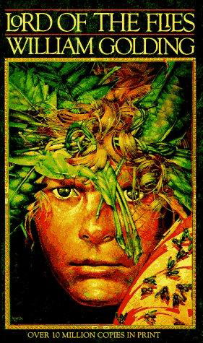
On Writing Lord of the Flies
“It was simply what seemed sensible for me to write after the war when everyone was thanking God they weren’t Nazis. I’d seen enough to realize that every single one of us could be Nazis.”
--William Golding

Slide 6
Inspiration
Golding once allowed his class of boys total freedom in a debate, but had to intervene as mayhem soon broke out
Experiences in war
Critical response to Coral Island by R.M. Ballanytyne
Philosophical questions about human nature

Slide 7
Philosophical Influence
John Hobbes
English Philosopher: 1588- 1679
Man is by nature selfishly individualistic
Man constantly at war with other men
Fear of violent death is sole motivation to create civilizations
Men need to be controlled by absolute sovereignty to avoid brutish behavior

Slide 8
Facts About the Novel
Rejected 21 times before it was published
It was his first novel- published in 1954
Not successful until the early 1960’s
On the American Library Association’s list of the 100 Most Frequently Challenged Books of 1990-2000.

Slide 9
Story Synopsis
Set in mid 1940’s when Europe was engulfed in war.
A plane carrying British school boys is mistaken for a military craft and shot down.
Only the boys survive the crash and try to form a society and govern themselves.

Slide 10
Golding’s Message
“The theme is an attempt to trace the defects of society back to the defects of human nature.”
--William Golding

Slide 11
Themes
Survival
Power/leadership styles
Civilization vs. Savagery
Loss of Innocence
Human nature
Duality of man
Nature Vs. Nurture
Good Vs. Evil

Slide 12
Allusions
Use of the names Ralph and Jack as the main characters from The Coral Island.
Simon from the Bible “Simon called Peter”, Peter was the other boy’s name in The Coral Island
Mention of Coral Island and Treasure Island
Numerous biblical allusions throughout

Slide 13
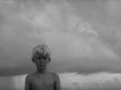
Golding’s Literary Technique
Heavy use of symbolism
Irony
Abundant imagery and sensory detail
Figurative Language
Simile
Metaphor
Personification

Slide 14
Lord of the Flies in Pop Culture
In Hook, Robin Williams compares Lost Boys to savages in LOTF
The Simpsons episode “Das Bus” is a parody
Inspiration for the anime series Infinite Ryvius
Mel Gibson’s 2006 movie Apocalypto has a similar ending.
T.V. shows Survivor and Lost are said to have been inspired from LOTF
2006 movie Unaccompanied Minors makes reference to LOTF

Slide 15
Popular Culture Cont.
Stephen King uses the name “Castle Rock” (from the novel) as the name of a town in his books. He also makes reference to LOTF in the novels The Girl Who Loved Tom Gordon, Cujo and Hearts in Atlantis
Orson Scott Card makes reference in his novel, Ender’s Shadow.
Degrassi: The Next Generation, Danny Phantom, The Daily Show all mention the novel

Slide 16
Source of Inspiration to Musicians
Musicians Iron Maiden, Gatsby’s American Dream, Nine Inch Nails, Tori Amos, A.F.I., and Danielle Dax have all recorded songs about the novel.
Titles such as:
“Where the Flies Are”
“Touch Piggy’s Eyes”
“Lord of the Flies”
“Piggy
“Fable”

Slide 17
The End
“Ralph wept for the end of innocence, the darkness of man's heart, and the fall through the air of the true, wise friend called Piggy."
- William Golding, Lord of the Flies, Chapter 12

