Slide 2
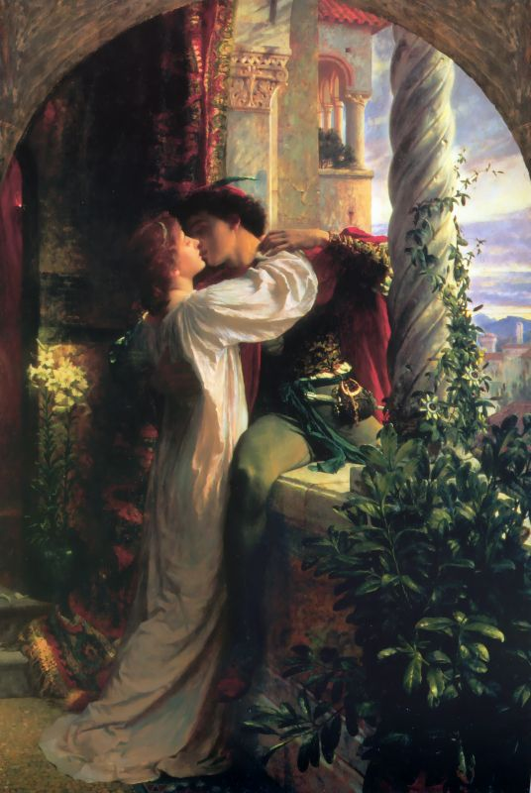
Romeo and Juliet as Tragedy
The whole play is tinged with sadness because in the prologue, we are told the characters die.
The main reason they die is due to fate or “the Heavens”
They are innocent victims of their parents’ feud.
We enjoy watching them fall in love and wish them well but it is heartbreaking when things fall apart for them.

Slide 3
Theme TOPICS
Key Theme TOPICS:
1. The nature of love
2. Individual versus society
3. The inevitability of Fate
4. Youth Versus Age
5. The danger of irrational, rash behaviour

Slide 4
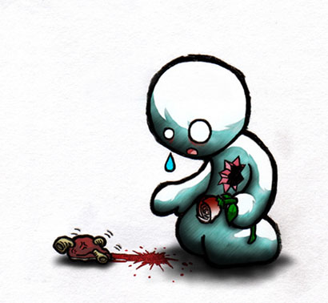
The Nature of Love
Love is presented in very different ways in Romeo and Juliet
On the one hand it is a beautiful, gentle thing
It is also hurtful, and brutal.

Slide 5
The Nature of Love
1. Shakespeare shows the true nature of love through his use of language
He uses oxymorons to reflect the contradictory nature of it:
“O brawling love, o loving hate,
O anything of nothing first create!
O heavy lightness, serious vanity” (act 1, scene 1)
This example from early in the play is before Romeo genuinely falls in love. Interestingly, it is a true reflection of love as things turn out for him.

Slide 6
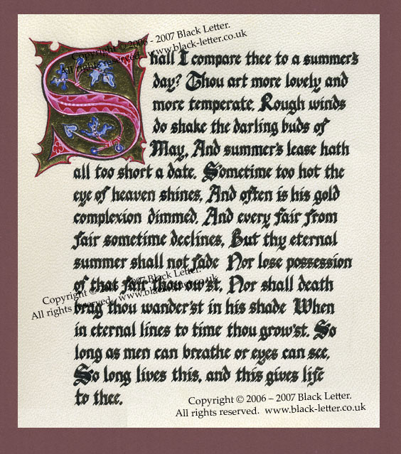
The Nature of Love
Shakespeare also uses poetic form to highlight the beauty and passion of the love Romeo and Juliet share.
The couple share the lines of a sonnet when they first meet.
A sonnet is a 14 line poem with an iambic pentameter meter and a specific rhyme scheme.
Some of the imagery used is genuinely beautiful…

Slide 7
The Nature of Love
“Love is a smoke made with the fume of sighs:
Being purged, a fire sparkling in lovers’ eyes;
Being vexed, a sea nourished with loving tears.”
“This bud of love, by summer’s ripening breath,
May prove a beauteous flower when next we meet.”

Slide 8
The Nature of Love
Being in love changes the characters too.
At first, Romeo has “a soul of lead” that “stakes” him to the ground.
This contrasts with the way he climbs over the Capulet wall after he meets Juliet:
“With love’s light wings did I o’erperch these walls”

Slide 9
The Nature of Love
Love causes the couple to act rashly, though, and their reaction to situations that keep them apart is, ultimately, to kill themselves. In this respect, love provokes violence. It heightens tensions and passions and leads people to do things rashly.
In this sense, love is closely related to death. This is no more clearly shown when Romeo first notices Juliet and Tybalt spies him.

Slide 10
The Nature of Love
The power of love is reflected in the way Shakespeare uses religious imagery to describe it. Romeo and Juliet both use this type of language in their sonnet in Act 1
R: This holy shrine, the gentle sin is this:
My lips, two blushing pilgrims ready stand
To smooth that rough touch with a tender kiss.
J: Good pilgrim you wrong your hand too much,
Which mannerly devotion shows in this –
For saints have hands that pilgrims’ hands do touch
And palm to palm is holy palmers’ kiss.

Slide 11
The Nature of Love
Love is compared to elements of nature at various points in the play. Figurative language is used extensively:
“Too like the lightning, which doth cease to be
Ere one can say “It lightens”
“This bud of love, by summer’s ripening breath,
May prove a beauteous flower when next we meet”
“My bounty is as boundless as the sea,
My love as deep”

Slide 12
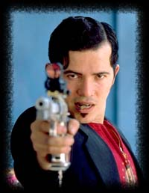
Individual Vs Society
Romeo and Juliet both have to battle with the society they live in.
They are both constrained by the feud
Elements such as honour, patriarchal power, religion and the law all act as complications in the narrative.

Slide 13
Individual Vs Society
The feud is the main complication.
Their “names” may be irrelevant to them but it is crucial to everyone else.
“Tis but thy name that is my enemy.
Thou art thyself, though not a Montague”
“Call me but love, and I’ll be new baptized.
Henceforth, I never will be Romeo.”

Slide 14
Individual Vs Society (Honour)
The honour of the characters plays a large part in the demise of Romeo and Juliet.
The fights that erupt escalate because someone’s honour is called into question – “I bite by thumb at you”
Mercutio fights Tybalt (and dies) because he is horrified at Romeo’s capitulation in the face of Tybalt’s insults – “O calm, dishonourable, vile submission!”

Slide 15
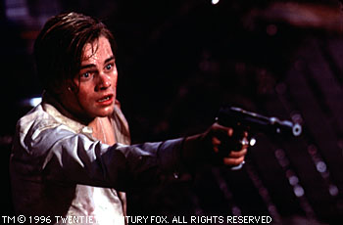
Individual Vs Society (Honour)
Romeo, in turn, kills Tybalt in revenge, claiming
“O sweet Juliet –
Thy beauty has made me effeminate,
And in my temper softened valour’s steel.”
Paris also tries to defend Juliet’s “body” as an act of honour.

Slide 16
Individual Vs Society (Patriarch Power)
Both Capulet and Montague exert a great influence on their families. They are the catalysts of the feud and do little to discourage the fighting.
Capulet in particular is presented as a typical renaissance father – he is very much in charge and expects Juliet to obey his instructions in any matter.
When Juliet refuses to accept the marriage to Paris, he reacts angrily…

Slide 17
Individual Vs Society (Patriarch Power)
“I’ll give you to my friend:
And you be not, hang, beg, starve, die in the streets! –
For, by my soul, I’ll ne’er acknowledge thee..”
This reaction places Juliet in a very vulnerable position and she finds herself completely alone as a result. She has to make her own decisions and cut herself off from her family. ( a family that she loves)

Slide 18
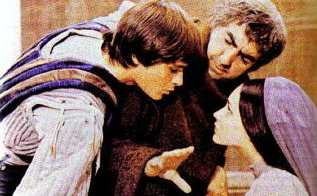
Individual Vs Society - Religion
Religion played a much larger part in people’s lives than it does for many people today.
Many of the speeches and actions of Romeo and Juliet would be regarded as blasphemous.
The intensity of their love leads them to “break the rules”

Slide 19
Individual Vs Society - Religion
Romeo and Juliet wait till they are married before consummating their marriage
Juliet is affronted when she believes Romeo wants more than just courtship during the balcony scene – “What satisfaction cans’t thou have tonight?”
However, their suicides are mortal sins and would be seen as very un-Christian. It is a powerful way of expressing the power of their love.
The way they speak of each other in religious terms would also be seen as blasphemous.

Slide 20
Individual Vs Society - Law
The law acts as a complication in that the Prince’s decree after the brawl means that Romeo is banished. He has to break that law to be with Juliet on their wedding night and also to be with her in death.
Romeo breaks the law by buying poison. - “I pay thy poverty and not thy will.”
Where the Prince advocates calm and order, the passion of the characters in their hate, (and R +J’s hate) leads to disaster.

Slide 21
The Inevitability of fate
In Shakespeare’s day, it was believed that fate was a power that was vested in the movement of the stars.
References to the stars would have had this significance to the Elizabethan audiences.

Slide 22
The Inevitability of fate
From the outset, Romeo and Juliet are described as “star-crossed lovers” who take their lives.
This ties in with the idea that one’s future is pre-determined. No matter what they do to avoid it (or otherwise), their death will happen. This permeates the whole play.

Slide 23
The Inevitability of Fate
There are constant references to the idea that their destiny is pre-destined. Here are some examples:
“I fear, too early – for my mind misgives
Some consequence, yet hanging in the stars”
“He that hath the steerage of my course
Direct my sail!”
“Thou desperate pilot – now at once run on
The dashing rocks thy seasick weary bark!”
“Then I defy you stars!”
How many more can you think of?

Slide 24
The Inevitability of Fate
Both Romeo and Juliet see terrible omens relating to their lives.
These foreshadow their deaths at the end of the play
They help to remind the audience that these “star crossed lovers” take their life.
“With this night’s revels, and expire the term
Of a despised life closed in my breast,
By some vile forfeit of untimely death”
Methinks I see thee, now art so low,
As one dead in the bottom of a tomb.
Either my eyesight fails, or thou look’st pale”
“I dreamt my lady came and found me dead – strange dream , that gives a dead man leave to think! –
And breathed such life with kisses in my lips that I revived …”

Slide 25
The Inevitability of Fate
This theme is closely linked to dreams. These omens often come in the form of dreams.
The power of dreams is debatable though.
Mercutio argues that actions born of dreams are more to do with the dreamer’s personality than any powerful force. (Queen Mab speech)
Romeo agrees with this early in the play as he states “Thou speak’st of nothing.”

Slide 26
The Inevitability of Fate
There is irony in the fact that Romeo, Juliet and the friar take actions to escape and break free from fate while all the time playing into its hands.
Romeo shouts “Then I defy you, stars!” and then makes plans to take his own life – just as fate would have it!
Similarly the plans they make to solve their difficulties all lead to their untimely deaths.

Slide 27
The Inevitability of Fate
An interesting variant on this theme is the idea that fate is simply a force that emerges from the personalities of the characters (in the same way Mercutio argues that dreamers simply act according to what they are like and what they do)
Perhaps Romeo and Juliet were just too passionate and rash – something the friar warned them about.

Slide 28
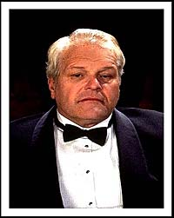
Youth Vs Age
The youth and passion of Romeo and Juliet contrasts with the wisdom of Friar Lawrence.
Shakespeare presents both of them with faults – the rashness of R + J and the ongoing feud between the parents.

Slide 29
Youth Vs Age
Friar Lawrence is the wise figure of the play. He advises Romeo:
“Wisely and slow. They stumble that run fast.”
“These violent delight have violent ends,
And in their triumph die – like fire and powder,
Which, as they kiss, consume.”

Slide 30
Youth Vs Age
Compare the friar’s words to those of Juliet:
“my true love is grown to such excess
I cannot sum up sum of half my wealth.”
Both Romeo and Juliet are quick to turn to suicide when things go wrong. It reflects the rashness of their youth.
Find examples in the play.

Slide 31
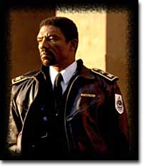
Youth Vs Age
The end of the play sees the Prince addressing Montague and Capulet.
He makes them realise the folly of their actions and the feud is resolved.
It takes the death of their children to make them realise. As the Prince states, “all are punished.”

Slide 32
Language in Romeo and Juliet
Shakespeare’s language is one of the elements that makes his work so magical.
The play is full of metaphor which gives the text a richness that is almost unsurpassed.
Shakespeare also uses poetic form and punning to help his characterisation.
Characters with status and intelligence speak in verse, while characters from the “lower classes” speak only in prose. This creates a contrast between them.

Slide 33
Language in Romeo and Juliet
Romeo and Juliet share a sonnet, the traditional form used for love poetry, when they first speak to each other. This highlights the shared attraction and genuine nature of the love that is growing.

Slide 34
Language in Romeo and Juliet
This sense of intelligence is also portrayed through the characters’ ability to engage in punning.
Romeo and Mercutio exchange words at the beginning of Act II, Scene 4.
Mercutio’s character is likeable because he has the wit and intelligence to mock those around him. It is one of the qualities that we admire.

Slide 35
Language in Romeo and Juliet
Juliet also shows her wit and intelligence through her use of language.
She manages to conceal her true feelings for Romeo from her mother while still agreeing with her. This is done through skilful writing on Shakespeare’s part:
“Indeed, I never shall be satisfied
With Romeo till I behold him – dead –
Is my poor heart, so for a kinsman vexed.”

Slide 36
Language in Romeo and Juliet
There is a contrast between the imagery used by Paris and Romeo.
Where Romeo is passionate and genuine, Paris is sincere but a little staid.
Find examples which highlight the difference.

Slide 37
Motifs – Light and Dark
Light and darkness are continually referred to throughout the play.
At different times, the characters prefer one to the other.
It is not as simple as light is good and dark is bad.
Each one symbolises something different depending on the situation.

Slide 38
Motifs – Light and dark
Juliet is described by Romeo using light imagery in the balcony scene.
“Arise, fair sun and kill the envious moon”
“The brightness of her cheek would shame those stars
As daylight doth a lamp.”

Slide 39
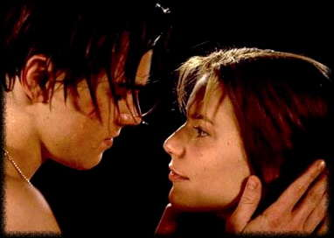
Motifs – Light and Dark
A similar blurring of night and day occurs when the two lovers wake after their first night together.
“It was the nightingale, and not the lark,
That pierced the hollow of thine ear”
They debate over the light, wishing it to be night.

Slide 40
Motifs – Light and Dark
In this case, the couple want it to be night because it offers them concealment.
This relates to the theme of the individual vs society.
The darkness offers them privacy and secrecy, hiding their relationship and Romeo’s presence in Verona.
The dual nature of light and dark is reflected in Romeo’s line, “More light and light, more dark and dark our woes.”

Slide 41
Motifs – Light and Dark
It has been argued that the recurring images of light and dark hint at the alternatives available to the couple. This then ties in with the theme of fate.

Slide 42
Motifs - Dreams
As mentioned earlier, there are many dreams mentioned in the play, many of them foreshadowing the deaths of Romeo and Juliet.
The nature of dreams and their importance is contradictory though.
Mercutio mocks them in his Queen Mab speech as “children of an idle brain”

Slide 43
Motifs - Dreams
This contrasts strongly with both Romeo and Juliet who look on their love as real and powerful.
Their dreams are unnerving and poignant (and ultimately come true)

Slide 44
Dramatic Irony
Shakespeare uses dramatic irony extensively in the play.
It is vital in creating the tension.
At times Shakespeare “layers” the dramatic irony, making it harder and harder for Romeo and Juliet to escape their untimely deaths.
This is an important technique to refer to when writing about the play. There are many examples.
Note down as many examples as you can think of.

Slide 45
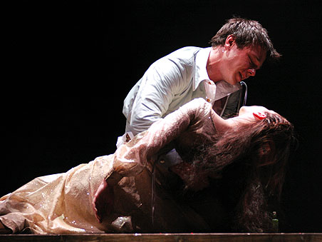
Dramatic Irony
Some of the most poignant moments in the play come from the knowledge that we cannot share with the characters. We are impotent.
When Romeo says the lines, “Beauty’s ensign yet is crimson in thy lips and in thy cheeks,
And death’s pale flag is not advanced there” it is heartbreaking because we know why – she’s alive!

