Slide 1
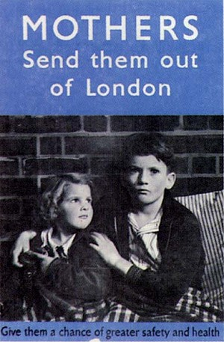

Slide 2
WAR & LOTF
Why did Golding write this novel?

Slide 3
How did Golding view war?
LOTF is an example of a literary work that reveals Golding’s view of man and his opinion of war
Moreover, society is a thin and fragile veil that when removed shows man for what he really is, a savage animal

Slide 4
A slow death of the civilized
Shortly after arrival, Jack and the boys encounter a pig, but Jack is not able to follow through because of society taboo’s concerning killing are still ingrained within
“The three boys rushed forward and Jack drew his knife again with a flourish. He raised his arm in the air. There was a pause, a hiatus, the pig continued to scream . . . the pause was long enough for them to understand what an enormity downward stroke would be” (28).

Slide 5
The thin veil is removed…..
Jack along with the boys display animal savagery when they kill the mother pig
“Jack was on top of the sow, stabbing downward with his knife . . . the spear moved forward inch by inch and the terrified squealing become a high pitched scream. Then Jack found the throat and the hot blood spouted over his hands” (149).

Slide 6
Absent from organized society, the boys of the Island become Golding’s view of mankind, vile and destructive
However, those who are civilized are still prone to violence when the boys try to replicate the British model of a democratic government symbolized by adults (conch)
These same civilized adults started the second world war that landed the boys on the island in the first place

Slide 7
A sign from the adult world…..
A dead parachute lands on the island from an air battle overhead symbolizing that the savagery of man exists in the civilized world
That is, Golding see’s war as an action of destruction
When removed from normal society, man reverts to what his nature deems him to be, a destructive creature

Slide 8
Assignment
Please compose an 11-sentence paragraph outlining the destructive nature of civilization into savagery on the island
Follow the 11-sentence paragraph with the following format:
Topic sentence outlining your three points
Point # 1 : Point, Quote and Explain
Point # 2 : Point , Quote and Explain
Point # 3 : Point, Quote and Explain
Concluding sentence to sum up your paragraph

