Slide 1
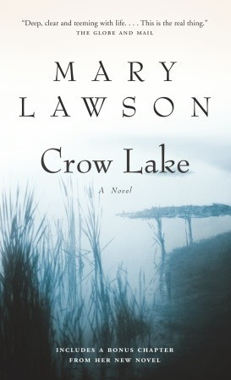
Crow Lake
CHAPTERS 11-12 INFORMATION
CHAPTER SUMMARIES
CHARACTER DEVELOPMENTS
OTHER INFORMATION
S. Wilson – ENG4C – spring 2016

Slide 2
Crow Lake
CHAPTER SUMMARIES
CHAPTERS 11-12 INFORMATION
Chapter 11: In the Past
Begins with Kate figuring out the information on Pye family from Mrs. Vernon
Chapter 12: In the Past
Kate (in present) remembers letters to Aunt Annie
Kate remembers life as a fog “smoke drifting through trees” – Everything is automatic
Mrs. Carrington comes home to see Luke – comments about Kate being so quiet
House in disarray: dirty dishes, laundry everywhere, a mess – Visualizes that family is struggling
Fight at school: Alex Kirby (random farm kid) and Laurie Pye
Kate observes marks (bruises) on Laurie’s back. Laurie leaves school, never to return
Chapter ends in present: Kate reflecting on her inability to put the bruises and stories about Pye family together, so she didn’t report anything. Foreshadowing: “wouldn’t have made any difference”
Increased frustration between Matt and Luke: What is the heart of the frustration? What are their roles?
Incident between Luke and Sally McLean: What happened?
Pressure on Luke as a result of Matt’s teasing and Sally McLean incident

Slide 3
Crow Lake
CHAPTERS 11-12 INFORMATION
CHARACTER DEVELOPMENTS
Readers are introduced to a number of new characters in these five chapters. Make sure you understand some of the qualities of:
Kate – Author explains how Kate couldn’t make connections between things as a child. What argument is being made about children? What is childhood innocence?
Luke/Matt – How does the setting in the home mirror the moods of the characters?
Pye Family – After the build-up in the last section, a series of events involving Laurie Pye is described. How does this impact Kate?

Slide 4
Crow Lake
MIDDLE OF THE NOVEL
CHAPTERS 11-12 INFORMATION
CONFLICT
By the middle of the novel, a number of conflicts have been introduced and developed. What are they?
Death of Parents
Pye Family
Luke and Sally
Kate and Daniel
How are these conflicts related?
What is the author teaching us through these conflicts?
Kate and Herself

Slide 5
Crow Lake
MIDDLE OF THE NOVEL
CHAPTERS 11-12 INFORMATION
PLOT
What were the most important parts of the story so far?
Death of Parents
Kate Retelling Story
Aunt Annie’s Arrival
Kate and Her Family
Luke Takes Over
Kate and Daniel’s Family
What events stick most in your mind? Why do certain plot points connect with us more than others?
Pye Family Incidents
Kate and Interest in Science
Luke and Matt Fight
Kate’s Inability to Help Laurie Pye

Slide 6
Crow Lake
MIDDLE OF THE NOVEL
CHAPTERS 11-12 INFORMATION
WRITING ASSIGNMENT
An INTERNAL MONOLOGUE is a piece of writing that reflects the inner thoughts of a character. In Crow Lake, we have spent a very long time hearing about events from Kate’s perspective, and this has including several internal monologues.
Create a written journal response outlining the main events of the novel from the perspective of any other character – however small or large their role in the novel. How does the change in perspective change the telling us of the story? How do they see things?
SUCCESS CRITERIA:
Shows an understanding of the main plot points of the novel’s first half
Shows an understanding of perspective and character
Is at least 350 words, showing development of ideas from the novel
Edited for spelling and grammar

