Slide 1
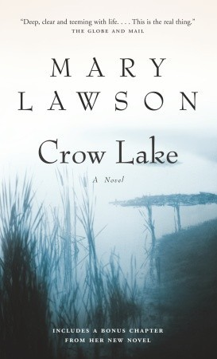
Crow Lake
CHAPTERS 13-15 INFORMATION
CHAPTER SUMMARIES
CHARACTER DEVELOPMENTS
OTHER INFORMATION
S. Wilson – ENG4C – spring 2016

Slide 2
Crow Lake
CHAPTER SUMMARIES
CHAPTERS 13-15 INFORMATION
Chapter 13 (Present and Past)
Kate and Daniel talk about empathy. This leads to their first argument
Kate notes that Daniel has always had it easy, has never had to struggle
Reflection on incident between Luke and Sally McLean
Luke does end up losing position at McLean store
Past to Present: Kate acknowledges that Daniel has seen birthday invitation
Kate goes to dinner with Daniel’s parents (Nothing really exciting here)
Kate invites Daniel to the party. This results in some different emotions
Chapter 14 (Takes Place in the Past)
Winter is a challenge, especially for Matt
Differences between Matt and Luke in terms of worry – Matt more concerned
This leads to “unrivalled time for magnifying tensions” (164)
Difficulty of Christmas. More anger building between Matt and Luke but also kindness of neighbours and community over Christmas with dinners, gifts, etc.
Hints throughout the chapter about Pye family. Matt and Luke agree Laurie gets hit.
Chapter 15 (Takes Places in the Past)
Memories of the kids together, potty-training Bo and teaching her nursery rhymes
Fun ends when Matt starts worrying about money. This sets Luke off. “Something will turn up.”
Matt plans to quit school to work at a store. This infuriates Luke
Luke: “You get your degree. Then you get a job, because then you’ll be able to get a good job. And then you can help, if we still need help” (179).
Tension boils over. Matt and Luke fight.
Something does turn up for Luke

Slide 3
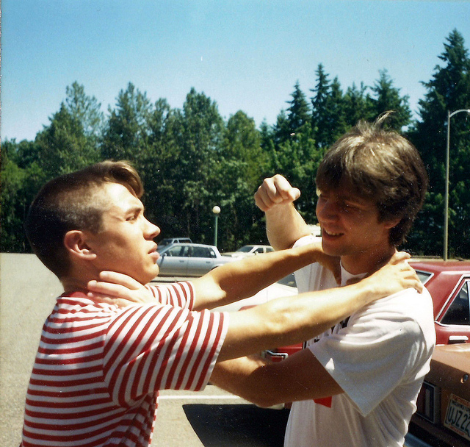
Crow Lake
CHARACTERS, CONFLICT & THEME
CHAPTERS 13-15 INFORMATION
The three chapters in this section all focus on character conflicts.
In Chapter 13, there’s a conflict between Daniel and his parents where Daniel just becomes absent. Also conflict between Kate and Daniel. This is resolved by Kate finally inviting Daniel to the birthday party.
In Chapter 14, conflict between Matt and Luke continues to develop. This ends with a focus on Pye Family: “They should have told Reverend Mitchell. But that’s hindsight speaking” (171).
Chapter 15 focuses on the conflict between Luke and Matt. Ends with a fight, but also a possible solution.
What is the author teaching us about conflict? Why the focus? How do all these conflicts connect to the novel’s themes?
-Tragedy
-Family
-Relationships

Slide 4
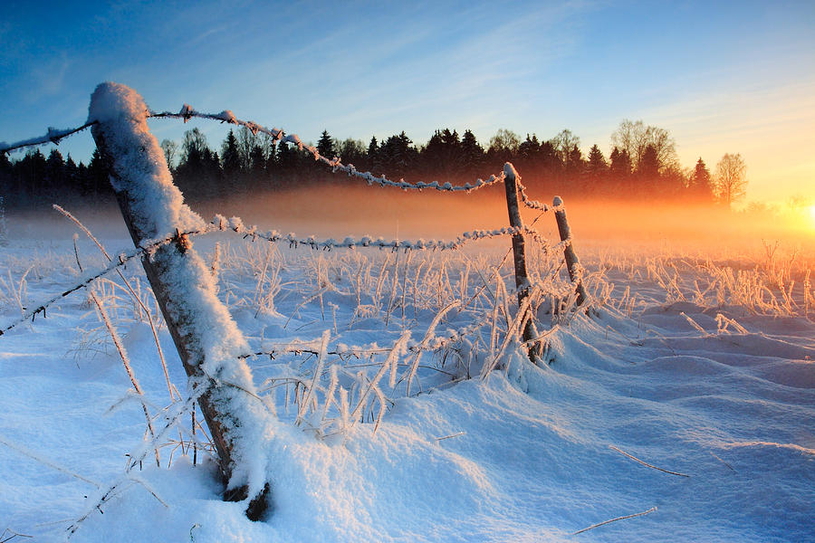
Crow Lake
SETTING & THEME
CHAPTERS 13-15 INFORMATION
Chapters 13-15 take place in the winter. How does the setting contribute to the tensions being experienced by the characters?
How would the story change in these chapters if Crow Lake took place in a city?
How does the setting develop the theme of ISOLATION? (And how does this theme connect to other stuff happening in the novel?

Slide 5
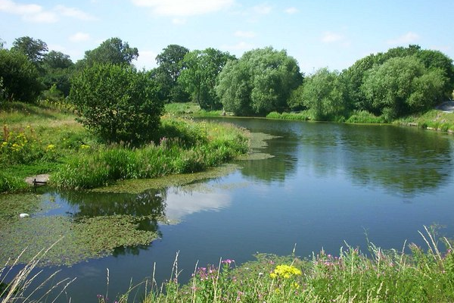
Crow Lake
THEMES
CHAPTERS 13-15 INFORMATION
A well-developed text includes multiple themes.
REMINDER: What is a theme? What’s the purpose of a theme?
In Crow Lake, we have identified the following themes. Keep track of them and be able to explain where/why/how they are part of the novel.
Tragedy
Family
Relationships
Isolation
Readers can come up with their own themes, as long as the text supports the idea or argument. (This can become the heart of a literary essay – what the novel is trying to teach the reader).
Are there any other possible themes in Crow Lake?

