Slide 1
Crow Lake
CHAPTERS 21-24 INFORMATION
CHAPTER SUMMARIES
THE IDEA OF TRAGEDY
PLOT AND CONFLICT
KATE’S CHARACTER
REVIEWING THE REVIEWS
S. Wilson – ENG4C – spring 2016

Slide 2
Crow Lake
CHAPTER SUMMARIES
CHAPTERS 16-20 INFORMATION
Chapter 21 (Takes Place in Present and Past)
Daniel and Kate headed into Crow Lake for party
Chapter 22(Takes Place in the Past)
Matt off with Marie Pye; Kate doesn’t see much of him
Chapter 23(Takes Places in the Present and Past)
Kate and Daniel continue driving towards home/Crow Lake
Chapter 24 (Takes Place in the Present)
Bo now 21, so this is 19-20 years past the events of Kate’s childhood
Information provided on Luke, Bo, and Matt as adults
Background information on Luke sacrificing his personality/sexuality
Foreshadowing Matt and Marie. “It would have happened by accident, the first time” (248).
Kate builds resentment towards Matt when they do have time together - jealousy
Kate finds Matt and Marie at the ponds
Kate’s reaction to Marie and Matt’s encounter: what is she feeling? Why must she keep a secret?
Marie’s frantic visit to the Morrison household and her news. Revelation of Calvin Pye’s violence: “Matt, he’ll kill me! He’ll kill me! Matt, he’ll kill me! You don’t believe me but he will! He killed Laurie, and he’ll kill me too!” (255)
Introduction of Daniel to family – no big deal
Matt and Marie live in Pye house / Luke and Bo live in Morrison household
Kate’s thought during dinner: how do you forget the horrible things that have occurred in the house
Pressure on Luke as a result of Matt’s teasing and Sally McLean incident
Switch to Past (Continuation of end of Ch. 22): Luke calms everyone down
Details about the murder of Laurie Pye
Suicide of Calvin Pye as police arrive – occurs in front of his wife. She ends up in mental hospital while youngest daughter sent away. Similar to Morrison tragedy?
Issue of Kate and Daniel sleeping in separate rooms
Awkwardness between Kate and Marie
Awkwardness continues as Marie talks about Matt’s happiness
Reunion with other characters from novel (town ladies, etc)
Ends with a trip to the ponds with Daniel

Slide 3
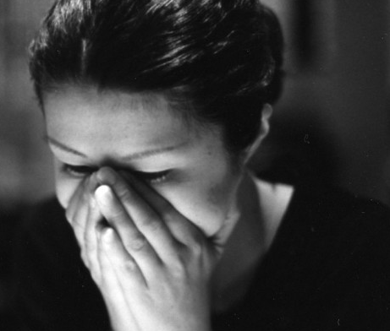
Crow Lake
TRAGEDY IN THE NOVEL
CHAPTERS 21-24INFORMATION
Discuss tragedy in Crow Lake. There are several examples of characters who deal with the idea of tragedy. Who and what are they?
Loss of Parents
Laurie’s Death
Entire Pye Family
Luke’s Guilt
What are your thoughts? Do the tragedies all have reasonable outcomes? Is the tragedy of the Morrison family comparable to the tragedy of the Pye family?
Is Crow Lake a novel about tragedy or is it a novel about something else?
What is the significance of the last two sentences of Chapter 23?

Slide 4
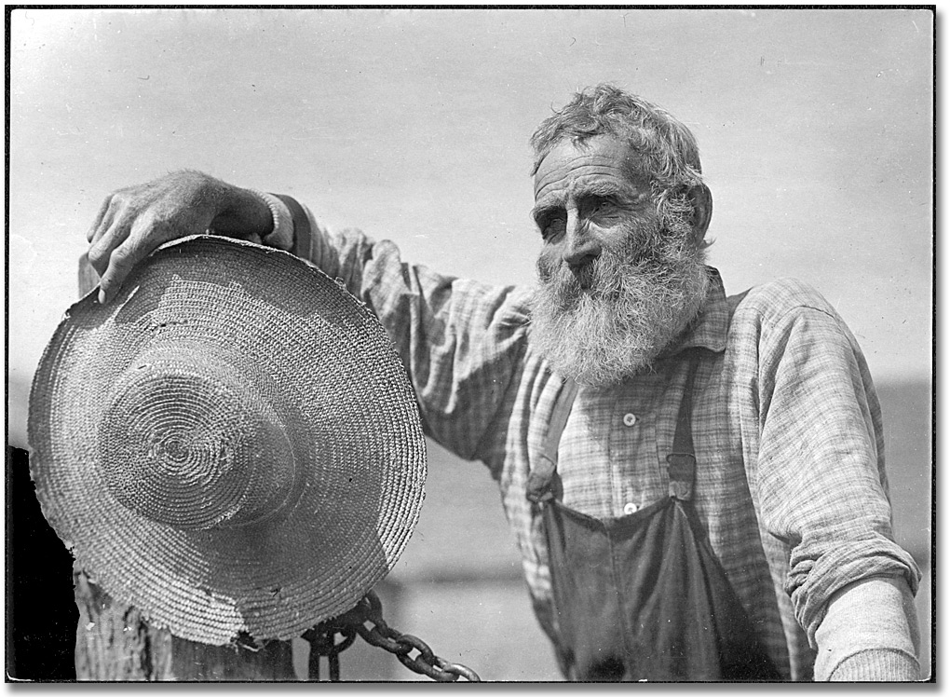
Crow Lake
PLOT & CONFLICT
It takes until Chapters 22-23 for the conflicts and plots of the Morrison and Pye families to come together.
Was Matt and Marie’s incident an accident? “I didn’t mean it to happen, Marie. I just couldn’t…. But it’ll be okay.” (252)
Was Laurie’s death really an accident? “He didn’t mean to kill him! He was hitting him, and he were trying to stop him, and he was hitting him, and Laurie fell! He hit his head on the blade of the plough! (269)
CHAPTERS 21-24 INFORMATION
As a class, discuss and review the following four main types of conflict. Provide examples from the novel.
Character vs. Character
Character vs. Society
Character vs. Nature
Character vs. Self
Which conflicts do you think are the most important? The most interesting? Why? Discuss as a class.
How does Calvin’s death compare with the death of the Morrison parents? Is either fair? Thoughts?

Slide 5
Crow Lake
KATE
CHAPTERS 21-24 INFORMATION
Brainstorm as many character traits as possible for Kate. For each trait, also try to think about why idea, theme, or lesson might be represented by Kate’s character. What is author Mary Lawson trying to get at with Kate’s character?
Record the information that the class provides. You will use this in the final assignment and possibly on the exam.
At the end of the novel, Kate brings Daniel to the ponds. What is the significance here to Kate and the story as a whole?

Slide 6
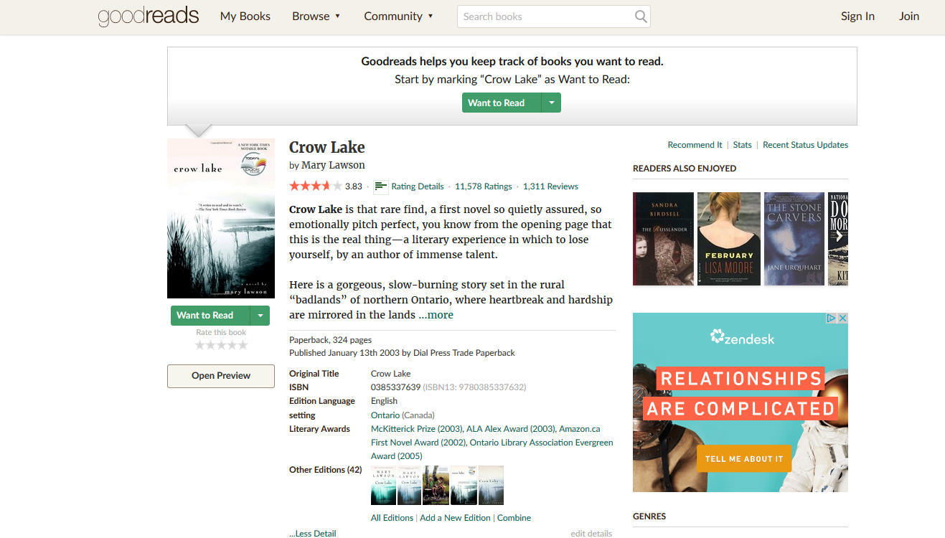
Crow Lake
FINAL THOUGHTS – CLASS DISCUSSION
CHAPTERS 21-24 INFORMATION
You can do this either with or without a partner.
Take a look at the GoodReads reviews for Crow Lake by visiting this link: http://www.goodreads.com/book/show/8646.Crow_Lake
Scroll through the reviews and find two reviews: one that is five stars and another with one or two stars. Read the review and prepare a response to it. Use reviews that make you think or cause you to have a definite opinion. Bland reviews that aren’t explained well don’t work.
Share your reviews with the class. First, read the review (or reviews) you chose and then provide your response. You must include:
An answer to the reviewer’s post
Specific reasons, examples, and explanations from the novel and your own ideas to support your answer

