Slide 1
The Indian Act
Native Studies

Slide 2
Canada Takes Control (1871)
The Department of Indian Affairs (DIA) was created to “look after” First Nations
No other ethnic group was targeted in this way

Slide 3
The Indian Act
This act gave legal power to the Canadian government to control the lives of First Nations
The Indian Act refers to First Nations people as “Indians” to this day..

Slide 4
Indian Act: Status Indians
The Indian Act determined who qualified as a Status Indian
Status Indians are considered “wards” of the Canadian government
The term “ward” is often used to describe children than need adult care.

Slide 5
Indian Act: Loss of Status
The following actions resulted in a loss of status..
marrying a man who was not a Status Indian
enfranchisement (until 1960, an Indian could vote in federal elections only by renouncing Indian status)
having a mother and paternal grandmother who did not have status before marriage (these people lost status at 21)
being born out of wedlock of a mother with status and a father without.

Slide 6
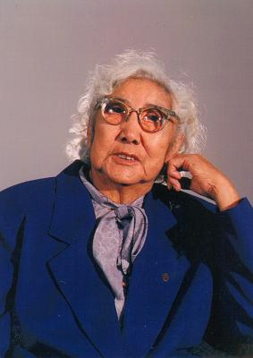
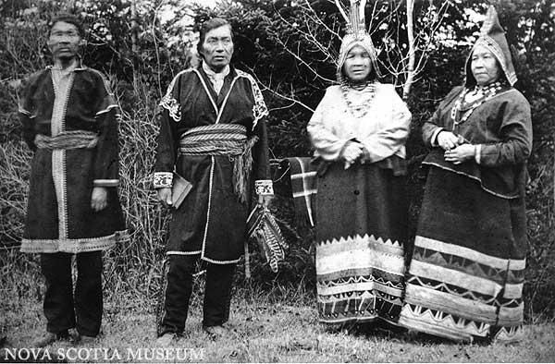
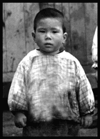
Indian Act – Indians as people?
Under the I.A. Status Indians were not considered “people” under the laws of Canada
This denied them certain rights..

Slide 7
Indian Act – Alcohol Use
Under the IA Status Indians were forbidden to own or consume alcohol
It was forbidden to sell alcohol to Status Indians

Slide 8
Indian Act: Voting
Since Status Indians were not “people” they could not vote in Canadian elections.
If they gave up status they could vote..
Will Canadian politicians be concerned about First Nations issues?

Slide 9
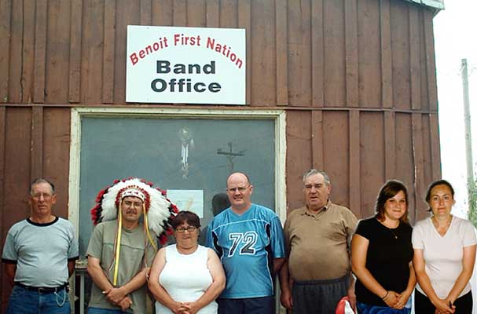
Indian Act: Political Interference
The I.A. ignored traditional First Nations forms of government (Hereditary)
It imposed the Euro-Canadian town council on First Nations
Band councils and chiefs would be elected, just like a mayor..
Assimilation

Slide 10
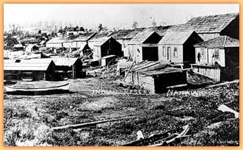
Indian Act: Reserves
Once the I.A. was passed, Status Indians were not permitted to own land
They were “wards” of the State (Canada)
Nanaimo, Indian Reserve #1

Slide 11
Indian Act: Reserves
First Nations were removed from their traditional territories and forced to live on “reserve” lands
Indian Reserves were usually small pieces of land, and were meant to be temporary.
Most reserve land was poor quality land, unsuitable for farming.

Slide 12
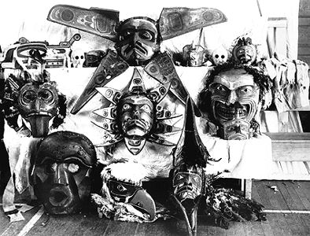
Indian Act: Potlatch Ban
1884 – Indian Act banned the Potlatch, attacking the culture of the Northwest Coast
Dance Regalia seized in 1921 at Alert Bay

Slide 13
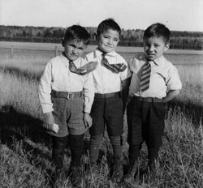
Indian Act: Residential Schools
The Indian Act of 1876 gave further responsibility to the federal government for Native education.
The result was the residential school system, a cooperation between Church and State to assimilate First Nations children.

Slide 14
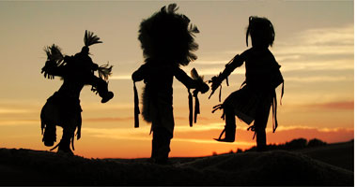
Indian Act: Amendments
1914: Amended to require western Indians to seek official permission before appearing in "aboriginal costume" in any "dance, show, exhibition, stampede or pageant."
Official Permission! Is this Canada?

Slide 15
Indian Act: Amendments
1930: Amended to prevent a pool hall owner from allowing entrance to an Indian who "by inordinate frequenting of a pool room either on or off an Indian reserve misspends or wastes his time
Huh?

Slide 16
Indian Act: Amendments
1927: Amended to prevent anyone (aboriginal or otherwise) from soliciting funds for Indian legal claims without a special license from the Superintendent-General.
This effectively prevented any First Nation from pursuing aboriginal land claims.

Slide 17
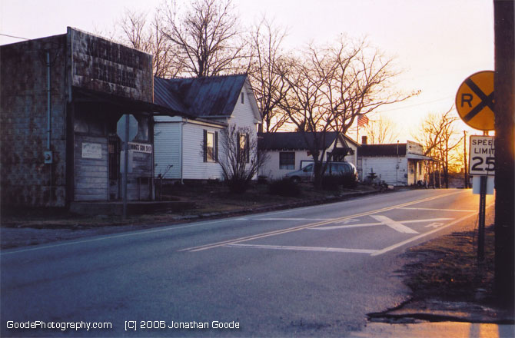
Indian Act: Amendments
1905: Amended to allow aboriginal people to be removed from reserves near towns with more than 8,000 residents
Yes, this happened in Canada!

Slide 18
Status Indians: Tax Exemption
In general, Aboriginal people in Canada are required to pay taxes on the same basis as other people in Canada (GST & PST)
except where the limited exemption under Section 87 of the Indian Act applies. Section 87 says that the "personal property of an Indian or a band situated on a reserve" is tax exempt.
The Indian Act prevents non-Aboriginal governments from taxing the property of Status Indians on a reserve
Is this benefit worth all that was lost?

