Slide 1
The Great Gatsby
The 1920s and the American Dream
Notes:
The 1920s were an era of “mindless materialism and consumption and pursuit of private wealth.”

Slide 2
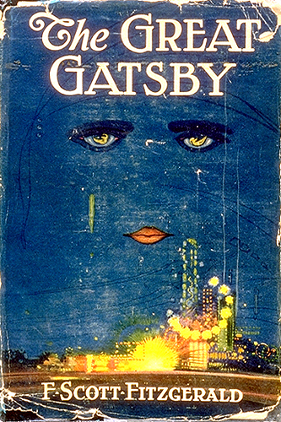
Notes:
The book was written in the 20s and is a book about the 20s: the novel comments on the gaiety and the moral decadence of the period, innumerable references the contemporary scene:
Wild, extravagant parties and the shallowness and the aimlessness of the individual.
Fitzgerald stresses the need for hope and dreams to give meaning and purpose to man’s efforts. But hopes and dreams have to fail because ideals standing behind both are mainly too fantastic to be realized.

Slide 3
The 20s: an age of transition
World War I and After
"The world must be made safe for democracy" Woodrow Wilson the President had declared, "Its peace must be planted upon the tested foundation of political liberty." --- a spirit of idealism Americans entered the war in 1917.
a general disillusionment among the people which caused nervousness: racism, intolerance, violence, Ku Klux Klan, immigrants, political intolerance "ghost of bolshevism" behind every form of social protest/ strikes.
1922 foreign policy of Isolationism
1929 Stock Market Crash
1932 New Deal era
Notes:
1918 the war had been won but nothing worth winning had been gained, because idealism had been used-up, that caused uneasy feelings and a general disillusionment among the people which caused nervousness: racism, intolerance, violence, Ku Klux Klan, immigrants, political intolerance "ghost of bolshevism" behind every form of social protest/ strikes.

Slide 4
Roaring Twenties
Economy booming
America partied
Organized crime
Prohibition Act
Decline of moral standards
Notes:
Decline or destiny? Period between wars.

Slide 5
OPTIMISM
business, change and innovation, laissez faire- economy
rapid growth of industry and mechanization: unlimited progress effecting an even wider distribution of the blessing of civilizations : electricity; automobile
even skeptics believe in progress and in solving of problems: new" Golden Age" for America
Notes:
View of contemporaries

Slide 6
CRITICS
they called the decade "decline and degradation"
Americans are caught up in a "surge of materialism", people who had failed to grasp the meaning and significance of life.
they feel disillusioned or disenchanted, they lost faith in life and in the possibility of social progress that caused their absolute lack of interest in politics.
Notes:
Mainly from literary intellectuals

Slide 7
SOCIAL ATMOSPHERE OF CHANGE
relaxing of structures within the sphere of private and public morality
relationship between the sexes
change of the status of women

Slide 8
SPIRIT OF THE 20s
urbanization and the move away from the land
fascination with the dream of success
development of the cinema as a medium of entertainment
popularity of jazz
increased mobility brought about by the mass produced automobile

Slide 9
PROHIBITION
the 18th Amendment(1919)prohibited the sale and consumption of alcohol.
although alcohol was illegal it was distributed through" bootleggers"
bootlegging means the production and sale of liquor.
alcohol was served in illegal night-clubs which were called "speakeasies"
it was the time of famous gangsters like Al Capone and events like the St. Valentine's Day massacre happened. During that time the Mafia became important in American society.
Notes:
In "The Great Gatsby" Jay Gatsby is suspected to be a bootlegger and a murderer. And Meyer Wolfshiem is said to have "fixed the World's Series" in 1919. Even Jordan Baker is someone who cheated at playing golf. Illegal gambling and bootlegging led to wide-spread corruption in the United States at that time. Prohibition is not taken seriously in "The Great Gatsby": in almost every chapter alcoholic drinks are offered.

Slide 10
THE CHANGING ROLE OF WOMEN
The 19th Amendment(1920) gave women the right to vote.
during the Twenties 9 million women were employed and earned money on their own, many younger women used their money to enjoy themselves
they were able to drink and smoke in public. For the first time female alcoholism is a major problem.
the liberated young women were called" flappers" In The Great Gatsby Jordan Baker is such a new type of woman. She is living alone and has equal relationships to men. She is self-confident in dealing with others. Tom comments on her new freedom as a woman.
Notes:
The role of women changed – their behavior, looks, and aims connected to the 20th century speed.
World War I brought about the first step towards a new role of women in American society. During the war women were employed in all jobs of the work force because of the manpower shortage. Then during the twenties they had found entrance to business and politics though in the very minority. In the work sector about ten million women earned money themselves now .
Suffrage In 1920 women's suffrage was finally fixed throughout the United States: The right ... to vote shall not be denied or abridged ... on account of sex. The Nineteenths Amendment didn't effect American politics.
Behavior But the relations between the sexes changed radically during the decade. Prohibition of alcohol reshaped into secret fun: men and women began drinking together at private cocktail parties which replaced the illegal saloon. Women started smoking. For those who could afford it the automobile became a further means of liberation. And they enjoyed sports like golf. On Saturday afternoon quite a few also attended the Big Game, watched football. The new dancing style expressed a new joy of life. The new woman revolted against being treated as a love object or male property. Feminist leaders fought against the general idea of women as a mother and housewife. The conduct shows the disintegration of the values and customs of the older generations.
Looks And just as well the looks of the young women experienced drastic change. Girls had their hair cut short like boys (in a bob) and went hatless. They wore short shirts or dresses and their coats reached only to their knees. These young women were known as flappers.
SexSexual relations were now more like open discussions. Some feminists denounced sexuality as a male problem. Some men described women as becoming frigid and masculine.

Slide 11
FACTS ABOUT THE DECADE
106,521,537 people in the United States
2,132,000 unemployed, Unemployment 5.2%
Life expectancy: Male 53.6, Female 54.6
343.000 in military (down from 1,172,601 in 1919)
Average annual earnings $1236; Teacher's salary $970
Illiteracy rate reached a new low of 6% of the population.
Gangland crime included murder, swindles, racketeering
It took 13 days to reach California from New York

Slide 12
Who is F. Scott Fitzgerald?
Born in 1896, in St. Paul, Minnesota.
He attended Princeton University.
1917 joined the army.
Met his wife Zelda.
Published The Great Gatsby at 23 in 1925.
Regarded as the speaker of the Jazz Age.
Drinking and wife’s schizophrenia
Died in 1940.

Slide 13
WHAT IS THE AMERICAN DREAM?
It describes an attitude of hope and faith that looks forward to the fulfillment of human wishes and desires.
“We hold these truths to be self-evident, that all men are created equal, that they are endowed by their creator with certain unalienable rights, that among these are life, liberty, and the pursuit of happiness.”
Notes:
These wishes were expressed in Thomas Jefferson’s Declaration of Independence.
The concept of the American Dream is presented from two different POV

Slide 14
SPIRITUAL AND MATERIAL IMPROVEMENT
Materialism achieved too quickly.
Thus, lacking spiritual life/purpose.
Gatsby is a character that represents this DREAM.
Notes:
The American Dream relates to a desire for spiritual and material improvement.
But what happened was the material aspect clearly outraced the spiritual ideals… it was achieved too quickly. So there emerged a state of material well-being but lacking in spiritual life or purpose.

Slide 15
FAILURE OF THE AMERICAN DREAM
Poverty
Discrimination
Exploitation
Hypocrisy
Corruption
suppression
Notes:
The American Dream has totally failed to bring any kind of fulfillment, whether spiritual or material.
For all the progress and prosperity, for all the declaration of democratic principles, there are still poverty, discrimination, exploitation
As far as morality and values, there are also hypocrisy, cu=corruption and suppression.
The Great Gatsby also comments on this. Condition.

Slide 16
How is this developed?
Through the 5 central characters
Through certain dominant images and symbols
Through diction.

Slide 17
The Roaring 20’s: A Brief but Comprehensive Introduction

Slide 18
The 1920’s
Known by names such as
the Jazz Age,
the Age of Intolerance,
and the Age of Wonderful Nonsense
The age that embodies the beginning of Modern America.
Post WWI and after pulling through a worldwide Flu epidemic many American’s felt hemmed up and the new decade would be a time of change for everyone---not always in a good way.

Slide 19
1920’s: Political
Herbert Hoover was elected to the presidency in 1928.
Popular with the people.
He was raised up by the country's prosperity until the beginning of the Great Depression began to carve its trough into the nation's economy early on his presidency.

Slide 20
1920’s: Social
Red Scares refer to the fear of Communism in the U.S. just before and during the 1920s
Historians often point out that Americans had withdrawn into a provincialism as evidenced by the reappearance of the Ku Klux Klan, restrictive immigration laws, and Prohibition the 18th amendment banning the manufacturing, sale and transport of intoxicating liquor.

Slide 21
1920’s: Social
However, many people disliked the law and imbibed in unlawful nightclubs called speakeasies. Gangsters took control of bootlegging (illegal distribution of liquor) and violent lawlessness erupted. Lacking public support, the federal government was virtually unable to enforce Prohibition.

Slide 22
1920’s: Social
Youthful "Flapper" women provoked older people with brief skirts, bobbed hair, and cavalier use of makeup and cigarettes.
Social crazes such as dances like the Charleston, dance marathons, flagpole sitting and flying stunts erupted.
Babe Ruth and other sports figures became heroes.

Slide 23
1920’s Arts & Writing
The lush, ornate style of Art Deco architecture, art, clothing, hairstyles, decor and furnishings flourished
The Harlem Renaissance
a rich period of American writing
Sinclair Lewis, Willa Cather, William Faulkner, F. Scott Fitzgerald, Carl Sandburg and Ernest Hemingway were prominent writers of the time period
Will Durant's The Story of Philosophy would sell millions of copies.

Slide 24
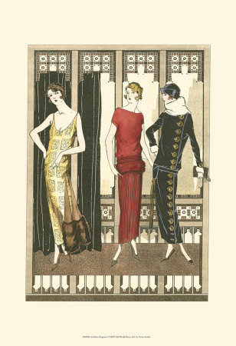
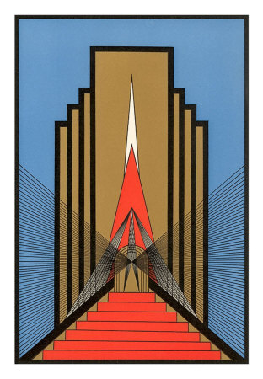

Slide 25
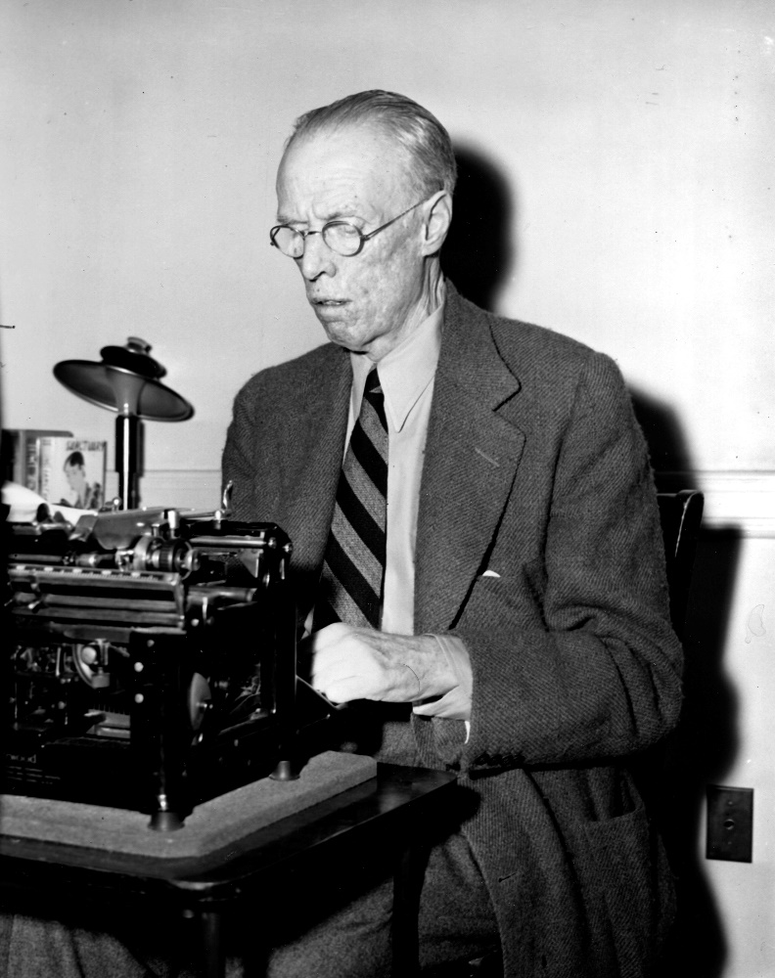
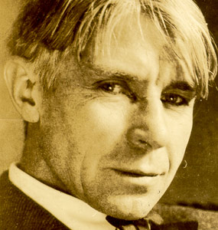
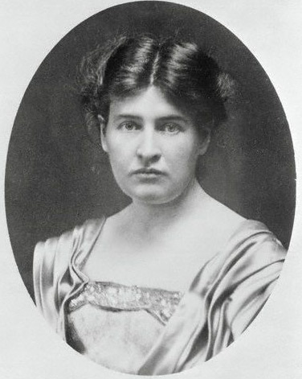
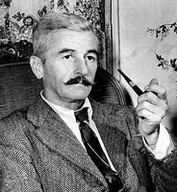
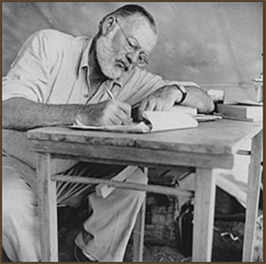

Slide 26
1920’s Arts & Writing
A uniquely American music form, with roots in African expression, came to be known as jazz
greats such as Louis Armstrong, Duke Ellington and Fletcher Henderson
George Gershwin, Cole Porter and others would bring jazz influences to Broadway and the concert hall.
Bessie Smith hallowed the Blues on a sound recordings.
first movie made with sound, The Jazz Singer, starring Al Jolson

Slide 27
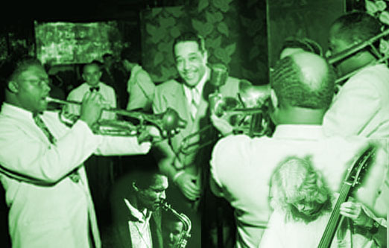
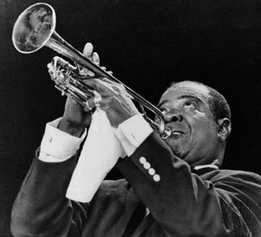
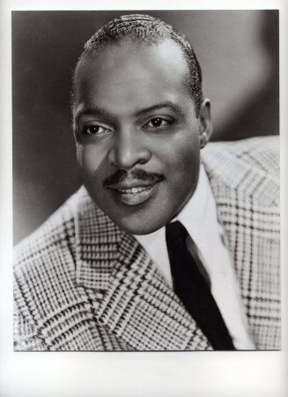
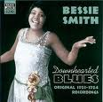
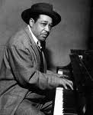
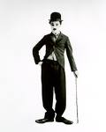
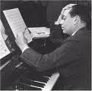
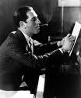
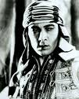

Slide 28
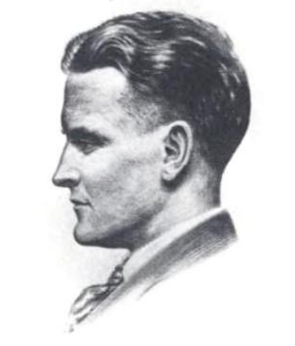
F. Scott Fitzgerald
Born September 24th, 1896 in St.Paul Minnesota
1911-1912 attended Newman, a Catholic prep school in NJ
Went on to Princeton University Class of 1917
Was on academic probation so he left school and joined the Army in his intended year of graduation

Slide 29
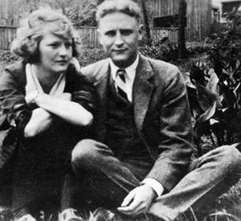
F. Scott Fitzgerald
While stationed in Alabama in 1918 he met and fell in love with his future wife Zelda Sayre
1919 is discharged from the Army
Married Zelda 1920 after he earned recognition for his work, This Side of Paradise
The two embark on an extravagant lifestyle that would lead to the trials and tribulations of both their lives and their relationship

Slide 30
F. Scott Fitzgerald
Fitzgerald becomes affluent with his play The Vegetable in 1922
By this time he is an alcoholic, it is documented that he always wrote sober…alcohol had become a major part of how he lived his life
His wife would often get “tight”(drunk) but was not known as an alcoholic

Slide 31
F. Scott Fitzgerald
The two moved frequently and lived in several places including: France, Alabama, Baltimore and Asheville, North Carolina.
Many of these places are where Zelda would receive treatments for her mental disorders
By 1931 Fitzgerald’s writing was an off and on practice because he was trying to take care of his ailing wife
By 1936 the marriage was virtually over and Zelda moved permanently to Highland Hospital

Slide 32
F. Scott Fitzgerald
In 1937 Fitzgerald tries his hand in Hollywood where he signed with MGM Studios and works until late 1938
Fitzgerald believed himself to be a failure
He became more notably recognized
post-humously
His 1924 work, The Great Gatsby has secured him a place in American History being called the example that “defines the classic American novel”

Slide 33
The Great Gatsby
1924
F. Scott Fitzgerald
Modernist Novel; a novel of manners

Slide 34
The Great Gatsby
Setting: The Summer of 1922 on Long Island and in New York City
THEMES:
The idea of the American Dream
The spirit revolving around the 1920’s
Social classes
The idea of symbols
Past, present and future

