Slide 1
Shakespeare’s Hamlet
An Introduction

Slide 2
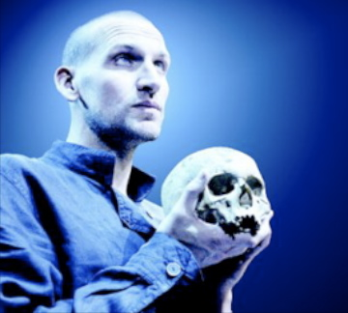
A Brief Introduction to Hamlet
Hamlet is a play that has fascinated audiences and readers since it was first written in around 1601-1604
The play centers around Hamlet’s decision whether or not to avenge the murder of his father, the King of Denmark. This weight of this decision drives all the other action and relationships in the play.
Hamlet is part of an old tradition of revenge plays, and is based on an old oral legend about Amleth, a prince whose father was killed by his uncle, who then married his mother.
Amleth pretends to be mad, while plotting how to avenge his father’s death, and eventually is able to kill his uncle.

Slide 3
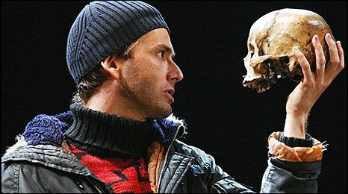
Who and What is Hamlet?
Critics have read this character as
A tragic figure whose flaw is an unwillingness to act
A representative of the human psyche (most famously Freud and Jung)
A modern individual fighting against the “old ways” of seeing and being in the world
Shakespeare took the basic plotline and created 5 stories in one!
Family Drama – An uncle has married the wife of his brother.
Love Story – Young love is forced apart by circumstance
Madness – A young prince may or may not have gone mad.
Revenge Play – death, murder, suicide, ghosts!
Political Thriller– Who should have the throne?

Slide 4
Hamlet as Political Survivor
Elsinore = Island
Political Alliances
Plotting
Scheming
Backstabbing
Real vs. Acting
Illicit Hookups
Getting voted off Permanently

Slide 5
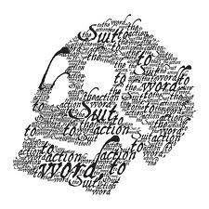
Hamlet: The First “Modern Man?”
Hamlet is also a play concerned with the question “Who Am I?”
First line of the play➔ “Who’s there?”
Is our role in life defined by fate? Family? Our own choices? Are we completely alone in the world, or are we irrevocably tied to others?
Hamlet’s struggle with these “existential” questions has led critics such as Harold Bloom and Freud to suggest that Hamlet is a representation of a fully modern man
Able to look at the stupidity, falsity, difficulty and sham of everyday life, without relying on easy answers

Slide 6
Key Thematic Questions in Hamlet
Revenge vs. Justice
What is the difference between revenge and justice? Is one more moral than the other?
Does the act of revenge irrevocably change an individual?
Action vs. Inaction
Is action always virtuous?
Is is possible to take action in a world where nothing is ever certain (i.e. morally black and white)
Fate vs. Autonomy
Do we have control over the shape of our own lives?
Are our roles in life always preordained?
Appearance vs. Reality
Is deceit a fundamental part of the way society functions?
Is life a series of “parts” that we “act” in order to get by?
Is there a “truth” under all the appearances in our lives?

Slide 7
Key Thematic Questions in Hamlet
Madness
Is insanity just a sane way of reacting to the madness of the world around us?
Loyalty and Betrayal
What constitutes loyalty?
To whom do we owe loyalty? Family? Lovers? State? Ourselves?
What happens when loyalties conflict?
Old Worlds vs. New Worlds
How does one function when caught between two world views?
What are the emotional/psychological/physical costs of this struggle?

Slide 8
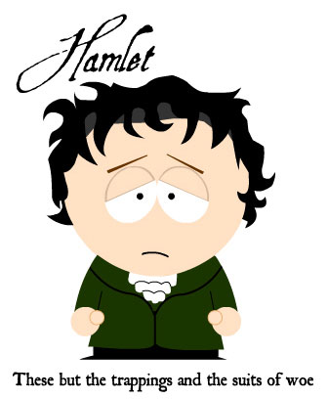
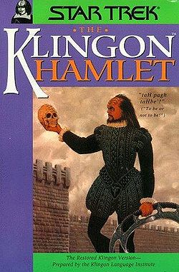
Hamlet as Pop Culture

Slide 9
Structural Devices in Hamlet

Slide 10
Dramatic Devices in Hamlet
Crisis: The moment or event in the plot where the conflict is the most directly addressed; the main character wins or loses; the secret is revealed; the ending of the story becomes inevitable
Usually found in Act III
Climax (Catastrophe): High point of tension and conflict; marks a major turning point for one or more of the characters
Usually found in Act V
Literary Devices
Review the devices on the handout and become familiar with them – it will be expected that you know and can refer to them while discussing the play.

Slide 11
While We Read Act I. i. . . .
What kind of atmosphere is Shakespeare trying to create here?
Why do you think the ghost does not speak?
Why do you think Shakespeare introduced Fortinbras so early in the play?

